Slide 1


E-Commerce Sales Performance Dashboard
Online Retail Dataset 2010-2011
Vivek Viswas Panda

Slide 2


TABLE OF CONTENTS
01
INTRODUCTION
02
OBJECTIVE
03
PROJECT WORKFLOW
04
DATA UNDERSTANDING & ISSUES
05
DATA CLEANING & PREPARATION

Slide 3
TABLE OF CONTENTS
06
DASHBOARD VISUALIZATION
07
KEY RESULTS & INSIGHTS
08
BUSINESS IMPACT
09
CONCLUSION & RECOMMENDATIONS

Slide 4



LOGO
INTRODUCTION
Dataset: ±540,000 Transactions | Period December 2010 – December 2011
Products: ±4,027 unique products (giftware, decorations, simple furnishings, toys, etc.)
Business Challenges:
Inconsistent product descriptions & many anomalies.
Promotions are only 1–3% → difficult to evaluate.
High returns, especially in the UK.

Slide 5






OBJECTIVE
STRATEGY & EVALUATION
Evaluate the Impact of Promotions and Pricing Strategies
MEASURING SALES
Measure Overall Sales Performance (Key KPIs)
IDENTIFICATION
Identify High-Performing & High-Return Products
PURCHASING & SALES ANALYSIS
Analyze customer purchasing patterns (time & geographical)
INSIGHT
Provide Visual Insight in the Form of a Dashboard

Slide 6





Project Workflow
DATA UNDERSTANDING
DATA QUALITY ISSUES
DATA CLEANING
DATA PREPARATION
The process of understanding the structure, content, and context of the dataset to determine what information is available.
Identification of issues within the dataset such as missing values, duplicate data, anomalies, or inconsistencies that can affect the analysis results.
The stage of fixing or deleting problematic data so that the dataset becomes accurate, consistent, and ready for analysis.
Data transformation and the creation of derived variables to be more relevant and suitable for analysis or visualization needs.

Slide 7



Project Workflow
Conclusion & Recommendations
Dashboard Visualization
Insights
Constructing the main thread (or narrative) from the analysis results and providing strategic recommendations.
Extracting key findings from the visualizations, such as customer purchasing patterns, promo effectiveness, or the most contributing products.
Presenting data in an interactive visual format (KPIs, sales trends, promotions, returns, best-selling products)

Slide 8

DATA UNDERSTANDING
Understanding the structure and content of the dataset, including the number of transactions, available variables, and business context.
Understanding the dataset structure:
541,909 transactions, 8 main columns.
Key variables:
InvoiceNo, StockCode, Description, Quantity, InvoiceDate, UnitPrice, CustomerID, Country.
The dataset covers the period
Dec 2010 – Dec 2011, with sales predominantly in the UK.

Slide 9


DATA QUALITY ISSUES
Identifying issues in the dataset such as missing values, duplicate data, anomalies, or inconsistencies.
InvoiceNo: has the prefix "C" (return/cancellation).
StockCode: 18 anomaly entries (AMAZONFEE, POST, etc.).
Description: ±20 thousand empty/invalid descriptions.
Quantity: has negative values (return/error).
UnitPrice: has zero, $<$1, and even negative values.
CustomerID: many transactions without ID.

Slide 10


DATA CLEANING
Cleaning and fixing data to be accurate and consistent, for example, deleting errors, marking returns, and separating anomalies.
Mark return transactions with the IsReturn flag.
Separate regular products vs. anomalies (admin fees, shipping costs, etc.).
Fix product descriptions via StockCode: the rest become Unknown.
Keep negative Quantity but mark it as a return.
Mark unnatural prices (0,<1, negative) as AnomalyPrice.
Transactions without CustomerID are still used in total sales, but excluded from customer analysis.

Slide 11

DATA PREPARATION
ccc
Performing transformations and adding derived variables (e.g., TotalSales, IsReturn, LabelPrice) so the data is ready for analysis.
Creating derived variables to make the data more ready for analysis:
TotalSales = Quantity × UnitPrice
IsReturn flag (0 = normal, 1 = return)
LabelPrice (Free, Very Low, Low, Normal)
TransactionType (Regular / Promo / Anomaly)
Datetime breakdown (Day, Month, Quarter, DayOfWeek, Hour)
Customer flag (With ID / Anonymous)
Result: The dataset is richer & ready to be used for the dashboard.

Slide 12
ccc
DASHBOARD OVERVIEW

Slide 13

KEY METRICS
💰 Total Revenue
🛒 Transactions
👤 Customers
📦 Products
€ 9,7M
25K
407K
5,1M
📊 Average Order Value
🔄 Return Rate
🎟️ Promo Sales %
⚠️ Anomaly Products
380
41%
2%
1%
Revenue reached €9.7M from 25K transactions and 407K customers. The average order value (AOV) is €380, showing stable purchasing.
However, the high return rate (40%) is a serious risk, while the promotional contribution is only 2%→ indicating promotional opportunities have not been optimally utilized.

Slide 14
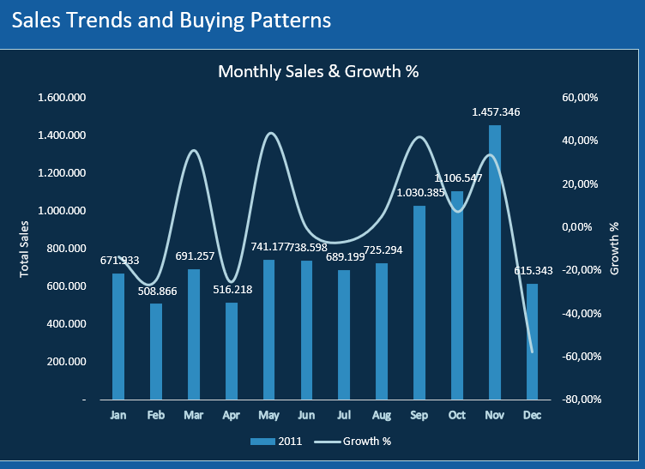
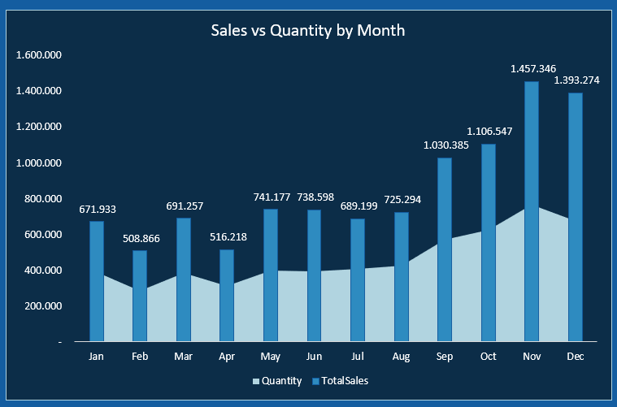
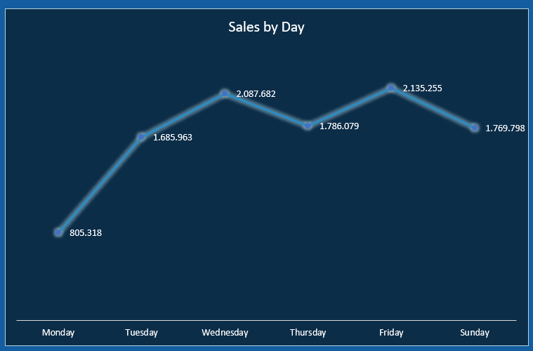
SALES TRENDS & PATTERNS
ccc
Sales surge in Q4 → seasonal pattern.
There is a gap between quantity vs. revenue → cheap products dominate.
Sales are stable throughout the week.

Slide 15
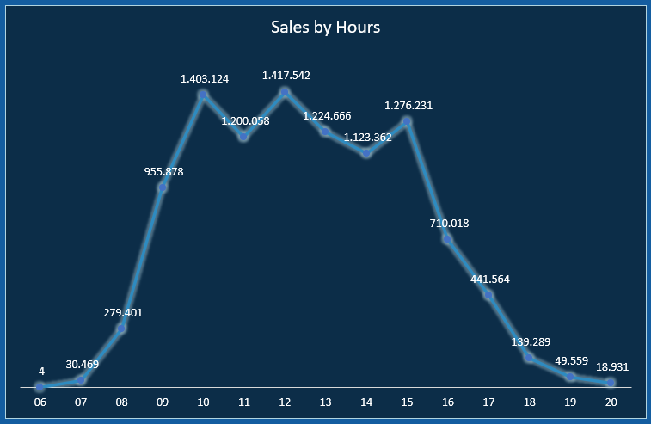
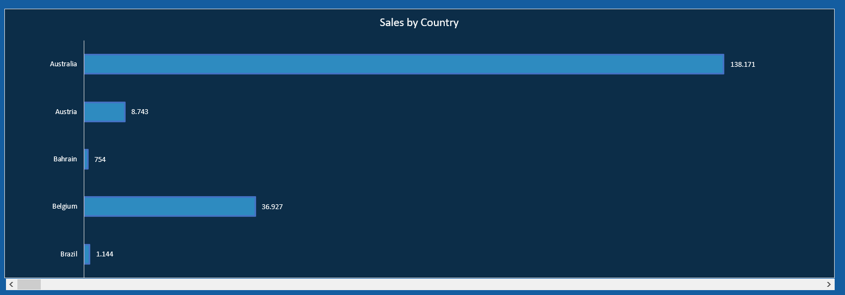
SALES TRENDS & PATTERNS
ccc
Peak transactions at 10:00 - 15:00 → opportunity for time-based promotions.
The UK dominates, but there are opportunities in other countries (EIRE, Germany).

Slide 16
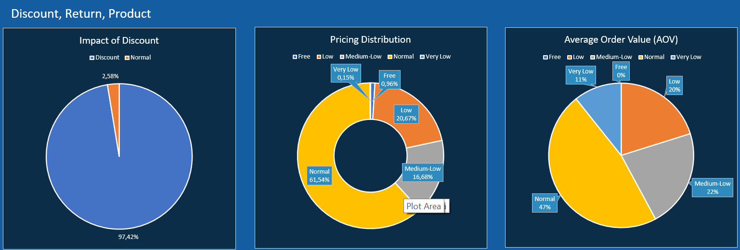
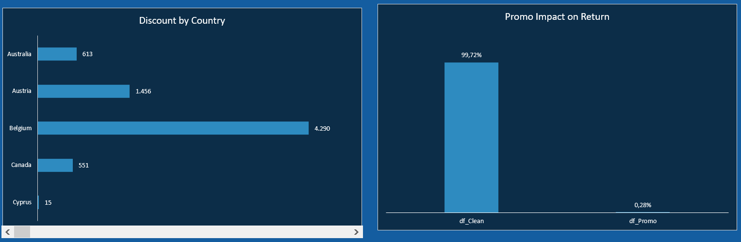
DISCOUNT, RETURN & PRODUCT
ccc

Slide 17
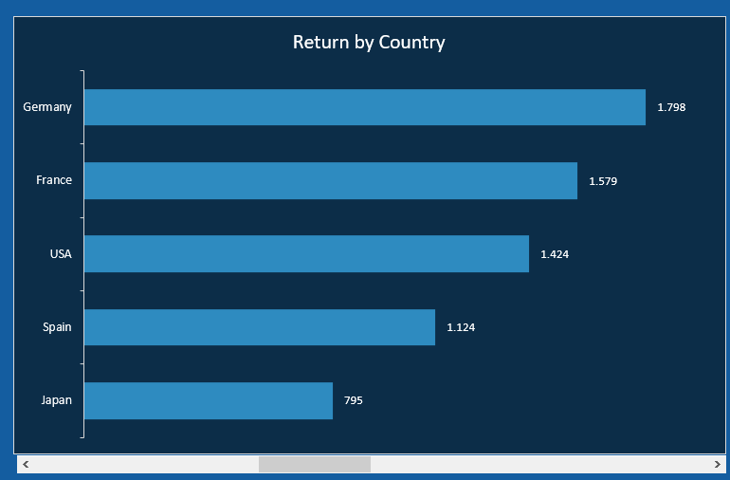
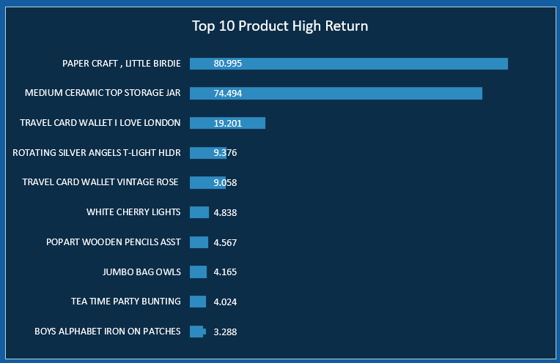
DISCOUNT, RETURN & PRODUCT
ccc

Slide 18
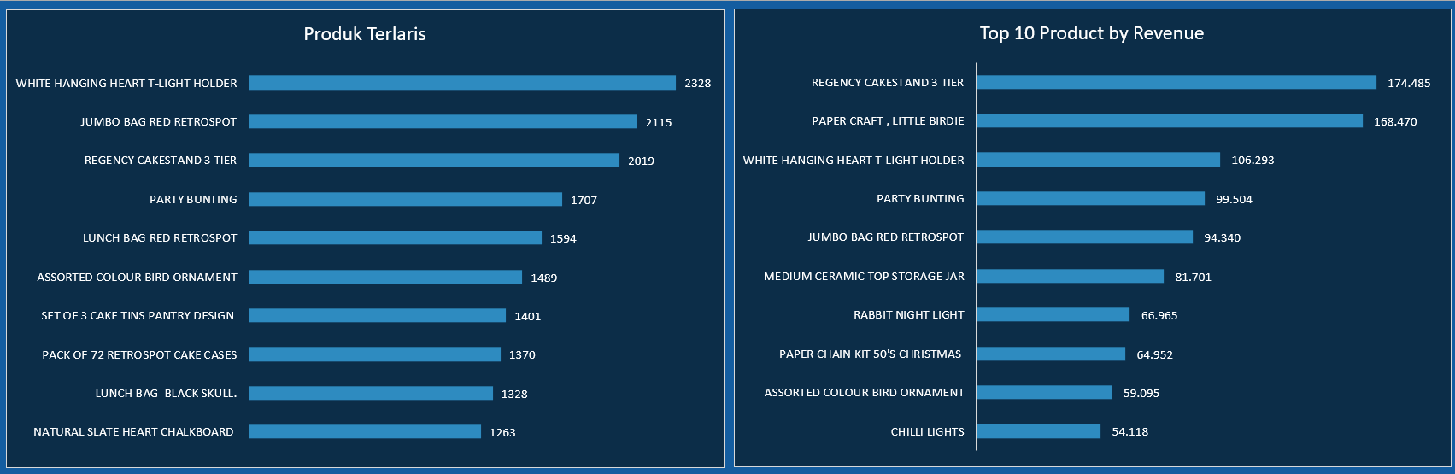
TOP PRODUCT
ccc

Slide 19
TOP PRODUCT
ccc

Slide 20
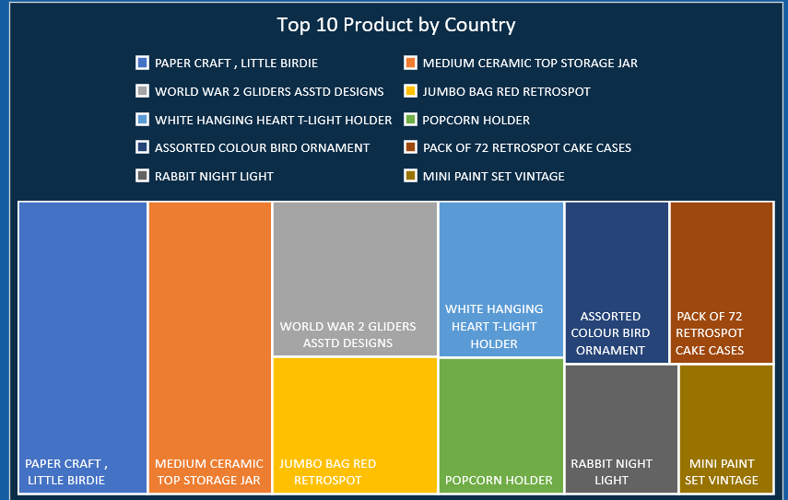
TOP PRODUCT
ccc

Slide 21
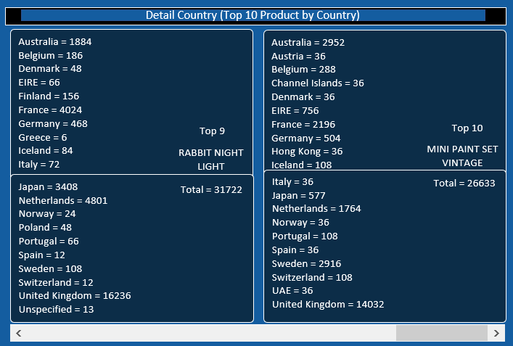
TOP PRODUCT
ccc

Slide 22

KEY RESULTS AND INSIGHTS
Summary of Analysis Outcomes And Business Findings

Slide 23
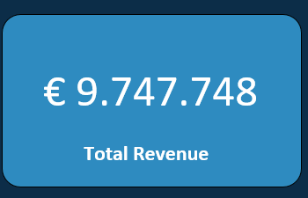
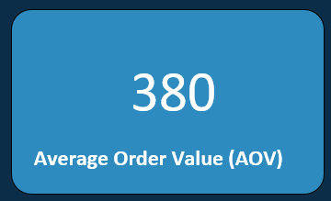
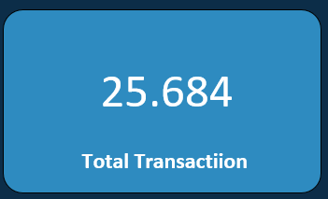
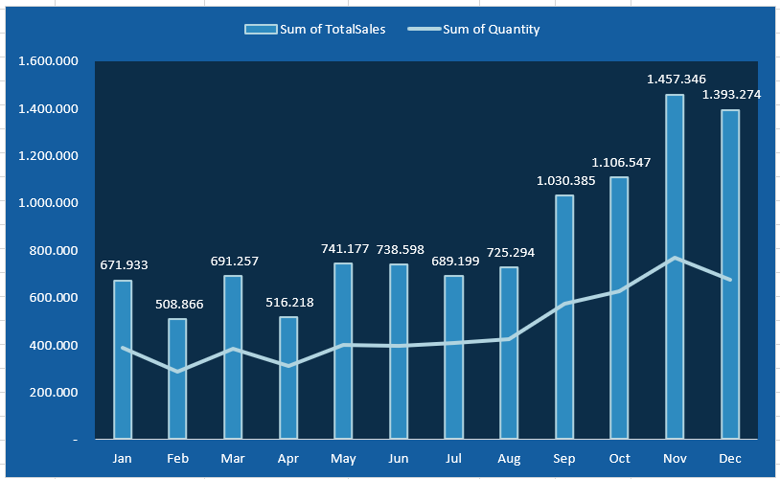
-
SALES PERFORMANCE
Total sales reached €9.7 million from over 25 thousand transactions.
Sales exhibit a clear seasonal pattern, with revenue increasing significantly in Q4, indicating a holiday surge.
Cheap products dominate sales volume (quantity), while premium products are the main contributors to total revenue.
The Average Order Value (AOV) is stable at €380, presenting an opportunity for upselling/cross-selling strategies to increase the basket size.

Slide 24
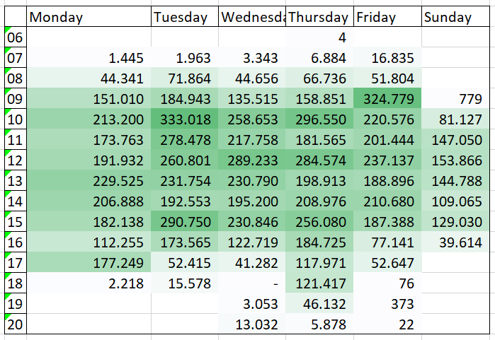
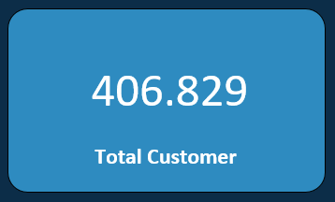
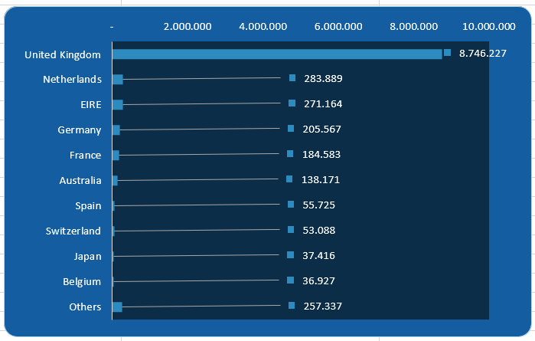
-
SALES PERFORMANCE
30+ Country
There are approximately 407 thousand unique customers, but many transactions lack a CustomerID, which hinders in-depth segmentation.
The United Kingdom dominates with >70% of revenue, but over 30 other countries contribute, signaling international expansion opportunities.
The daily pattern shows peak sales activity during working hours, specifically from 10:00 to 15:00, creating an ideal window for time-based promotions.

Slide 25
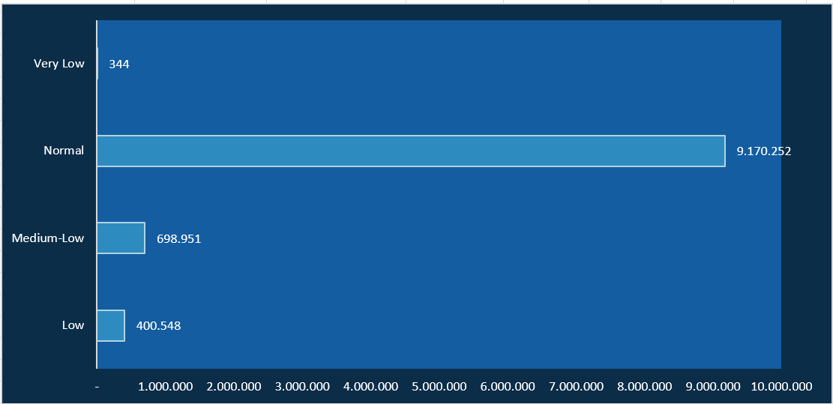
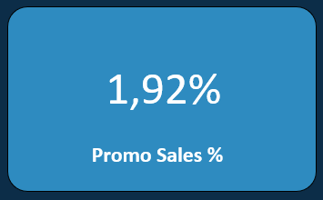
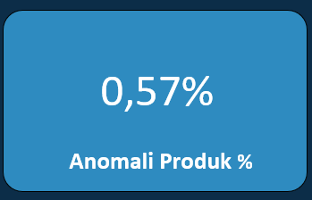
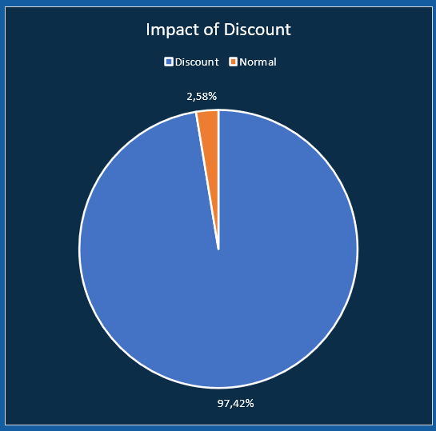
-
PROMOTIONS & PRICING
Promotions contribute only ±1−3% of sales, indicating very low promotional effectiveness.
The majority of products are sold at a normal price (>€1).
Products priced extremely low (<0.5) constitute only a small fraction, suggesting these are likely part of a bundling or bonus strategy.
Transactions with price anomalies are identified as ±0.57% of the data, which must be isolated to ensure accurate revenue analysis.

Slide 26
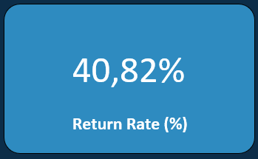
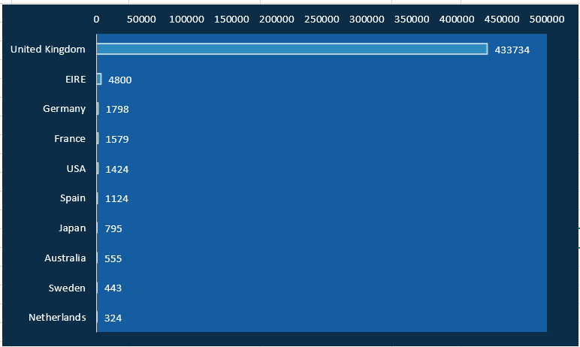
-
RETURNS & RISKS + TOP PRODUCTS

Slide 27
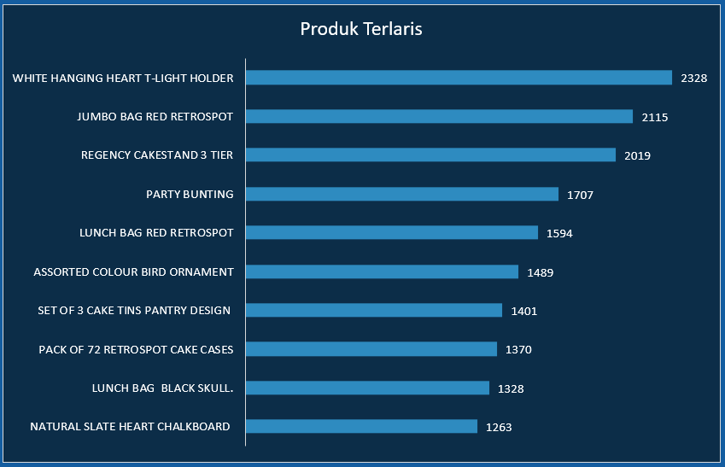
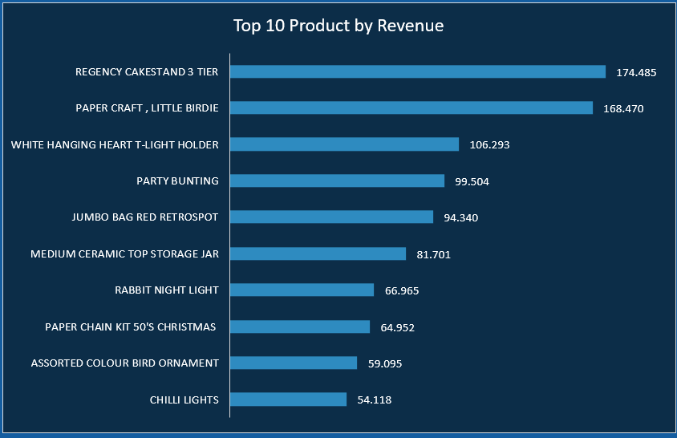
-
RETURNS & RISKS + TOP PRODUCTS
The high Return Rate (±40%) is a major risk to overall profitability.
The UK is the largest contributor to returns and must be the focus of the mitigation strategy.
Several popular products also have high return rates, suggesting potential issues with quality or a mismatch in customer expectations.
Top Products Insight:
Cheap giftware and decoration products act as volume drivers.
Premium products serve as profit drivers, despite low sales volume.
Varying preferences across different countries necessitate a localized strategy.

Slide 28
BUSINESS IMPACT
High Return Rate (∼40%): Profit margins are significantly eroded due to rising logistics, inventory, and customer service costs.
Low Promotion Effectiveness (∼2%): The current promotion strategy is ineffective, leaving the potential for sales increases via targeted campaigns untapped.
Time-based & Seasonal Pattern: The existence of peak transactions at 10:00-15:00 and in Q4 (holidays) opens opportunities for more targeted promotional campaigns.
Revenue Concentration on Premium Products: Premium items contribute substantial revenue despite low unit counts, creating an opportunity for increased profit through focused upselling & cross-selling.
Geographic Variation: UK dominance, coupled with varied preferences in other regions, necessitates a localized strategy for international expansion and return reduction.

Slide 29
CONCLUSION & RECOMMENDATIONS

Slide 30

Conclusion (Summary Findings)
Recommendations (Strategic Actions)
Return Management (Mitigating 40% Risk)
-Tighten quality checks and ensure product descriptions are clear and accurate to reduce misaligned customer expectations.
-Re-evaluate and potentially adjust return policies specifically for the UK and EIRE markets.
Promotion Strategy (Boosting 1.92% Contribution)
-Focus promotional campaigns during peak sales hours (10:00 to 15:00) and the high-volume Q4 period to maximize momentum.
-Direct promotions toward products with higher margins to ensure growth immediately translates into better profitability.
Product Portfolio Optimization
-Maintain cheap products as the "Volume Driver," but strategically increase the proportion of premium products to serve as the "Profit Driver".
Market Expansion & Segmentation
-Implement a local strategy for each country, tailoring product offerings and marketing based on specific national preferences.
-Optimize the potential of non-UK markets to diversify risk away from the UK, which is the primary source of high returns.
Customer Data Improvement
-Enforce the recording of CustomerID for all transactions to strengthen customer segmentation and long-term retention analysis.
The business operates under a high volume, thin margin model, where cheap products drive quantity while premium products serve as the main revenue engine.
A dangerously high Return Rate (±40%) is a serious challenge, disproportionately affecting the UK and EIRE markets.
Sales activity is heavily influenced by seasonal patterns (Q4) and specific time windows (10:00-15:00), indicating untapped time-based promotional opportunities.
Promotional efforts are highly inefficient, with a minimal contribution of only ±2% to overall sales.

Slide 31
Thank You

